Slide 1


RGB Music
Zehavit Leibovich & Oran Gilboa

Slide 2

Basic Idea
Let the user “hear” an image
OR
Create music from an image

Slide 3
Related Work
Notes:
תמצית עבודות דומות המתארת בצורה מדויקת את מה נעשה העבודות קודמות, מה הן
פתרו או הביעו, יתרונותיהן וחסרונותיהן.
http://www.kenjikojima.com/rgbmusic/
Pros:
A lot of options
Very advanced
Cons:
Not free
Out dated
Very complicated

Slide 4
The project
RGB Music is a software interface for creating music from an image through moving the mouse along the image.
In this project we aim to map between visual elements to sound elements. For example:
Map from the RGB value of a chosen pixel to unique instrument timbre
Map from a set of pixels (i.e the surrounding pixels of the chosen pixel) to pitch or time duration

Slide 5

Implementation notes & use case
The project will be implemented in Python using the following libraries:
Tkinter – UI
Pyo - Digital signal processing
Pil - Image processing
The main use case is very basic – just load the image and move the mouse along the image to create music

Slide 6
Cons over other products

Slide 7
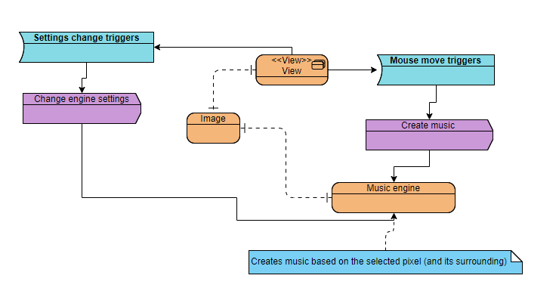
Technical and musical summary #1
System description

Slide 8
Technical and musical summary #2
The technical and musical details of the engine are to be defined : basically we want to have a unique instrument timbre for each RGB value and a mapping from a set of pixels (i.e. the surrounding pixels of the chosen pixel) to pitch or time duration
In the advanced phases of the project we would like to give the user the ability to change the engine settings (mapping from visual elements to sound elements) ad to give the user the ability to record its created music

Slide 9
UI scheme

Slide 10
Project timeline
Phase 1:
Implement an engine that creates a sound based on the RGB of the current pixel (according to mouse location)
Phase 2:
Add UI and logic for user input: Sliders, selection of instrument, etc.
Record the music created
Phase 3:
Add support for creating a music using multiple pictures

Slide 11
Bibliography #1
We were inspired by the video presented in class of “Geo shred preview”
https://www.youtube.com/watch?v=CDLA8B8BkbQ
Were you can see a musician play using a touch screen
Vuzik –A PAINTING GRAPHIC SCORE INTERFACE FOR
COMPOSING AND CONTROL OF SOUND GENERATION
Video: https://www.youtube.com/watch?v=Oq7c43mZYdY
Paper:https://quod.lib.umich.edu/cache//b/b/p/bbp2372.2012.108/bbp2372.2012.108.pdf#page=4;zoom=75
Musical Sonification of Super High Frequency Lighting

Slide 12
Bibliography #2
Musical Sonification of Super High Frequency Lighting – Paper:
https://quod.lib.umich.edu/cache//b/b/p/bbp2372.2017.039/bbp2372.2017.039.pdf#page=1;zoom=75
See music: A tool for music visualization – Paper:
https://quod.lib.umich.edu/cache//b/b/p/bbp2372.1993.114/bbp2372.1993.114.pdf#page=1;zoom=75
Video: https://www.youtube.com/watch?v=qNhwDzInBjo

Slide 13
חלוקת עבודה
Related work - Oran
Articles – Zehavit
The project – Zehavit
Use case – Zehavit
Cons – Oran
Technical summary - Zehavit
UI scheme – Oran
Videos – Zehavit

